Slide 1


ITE-7101: COMPUTER PROGRAMMING
AMA Computer University
Master of Science in Computer Science
Course Project Presentation
Presented By: Ramon Villamangca
Notes:
Good day, this is Ramon Villamangca. Today I am going to present to you the course project for ITE-7101 Computer Programming. ITE-7101 is one of the prerequisite courses required for graduate program MS Computer Science in AMA University. <click>

Slide 2


Presentation Outline
Part 1 | C++ Topical Presentation
Through the Loops
Dimension of Data Types
Introduction to Function Procedures
Part 2 | Programming Exercise Video
Prerequisite Topics to Part 2
Solution to Programming Exercise
Notes:
This presentation comprises of 2 parts. <click> The first one is the Topical Presentation. <click> And, part 2 is the Programming Exercise. <click>
The first part has 3 sections: (1. Through the loop…). I chose this topic because I am for the most part a functional programmer and most of the concepts in modern C++ is in the focus in replacing loops with functional approaches, introduction of new and more specific data types and the focus on FP rather than OOP. <click>
Part 2 has 2 sections. The first section is a rundown of prerequisite topics needed for our exercise solution. These are concepts that are not taught in the course module and would give us a more modern approach to our solution. The second section is the actual video of our solution.
With that let’s start our journey! <click>

Slide 3
Part 1: Topical Presentation
1. Through the Loops
Loops is programming flow control mechanism that allows a code block to be executed repeatedly, in the process called “iteration”.
Types of C++ Loops
C++ provides for both imperative and functional constructs of looping:
Imperative Loops:
Imperative For Loop
While Loop
Do-While Loop
Functional Loops:
Range-based For Loop
For-Each Loop
Notes:
(Loops is a programming…) <click> (C++ provides for both…) We will discuss both of this constructs. <click>. The imperative loops in C++ are: (Imperative…). <click>. While the functional loops are: (Range…). These are called “functional” because it tries to adhere to adhere the functional principle of “no side effects”. I will explain it when we get there. <click>

Slide 4
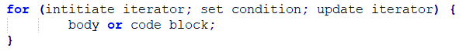
Part 1: Topical Presentation
1. Through the Loops
Imperative For Loop
Imperative For Loop is type of looping in which the number of iteration is clearly mentioned before the start of iteration. The code syntax is as follows:
An example will make this clearer.
Notes:
Now, we begin with Imperative For Loop. <click>. (Imperative…) <click>. For loops starts with the keyword “for” followed by the following inside parenthesis: the initial value of the iterator, a conditional statement stating the limit of iteration and the modification to be made to the iterator in each step of the iteration. All the parameters inside the parenthesis are separated by semicolon. This is then followed the code block (loop body) intended to be repeated, enclosed in curly braces. <click>. (An example…) <click>.

Slide 5
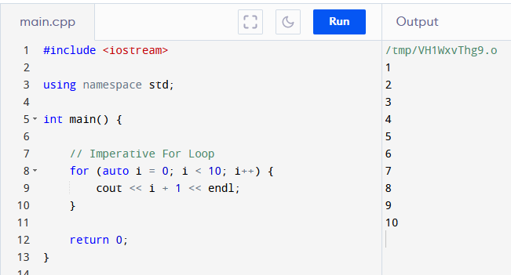
Part 1: Topical Presentation
1. Through the Loops
Imperative For Loop (Example)
Notes:
So in For loop. We first initiate the iterator. <click>. In this case i=10. (Don’t worry about the keyword “auto”, I will discuss it when we get to part 2).
Then we set the condition or limit. <click>. That is i<10. Then we tell the loop how to update the iterator in each step of iteration. <click>. That is increment by one. And then <click> we go to the loop body which tells the program what to do while the condition is still met. In this case print the value of i+1. <click> The output is the program prints numbers from 1 to 10 to the screen. <click>.

Slide 6
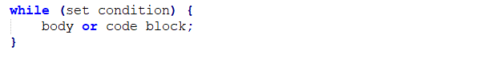
Part 1: Topical Presentation
1. Through the Loops
While Loop
While Loop is type of looping in which the loop body will only be executed “while” certain condition is still satisfied. If the condition failed, the loop terminates. The code syntax is as follows:
An example will make this clearer.
Notes:
Next we discuss while loops. (While Loop…) <click>. While loops starts with the keyword “while” followed by the condition to “continue” the loop, inside parenthesis, followed by the code block (loop body) intended to be repeated, enclosed in curly braces. It can also support iteration, but the iterator must be declared before the start of the while-block. <click> (An example…) <click>.

Slide 7
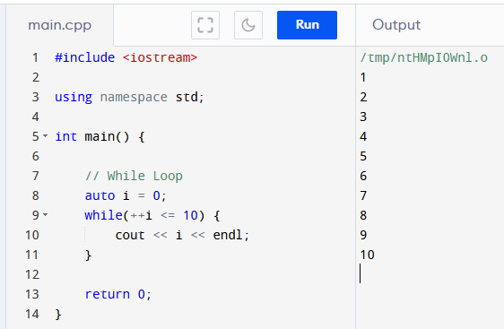
Part 1: Topical Presentation
1. Through the Loops
While Loop (Example)
Notes:
So in while loop. If there is an iterator (in this case “i”) we first initiate it “i=0” <click>. Then we set the condition <click>. In this case increment i and compare to 10. <click> And then <click> we go to the loop body which tells the program what to do while the condition is still met. In this case print the value of i. <click> The output is the program prints numbers from 1 to 10 to the screen. <click> <click>.

Slide 8
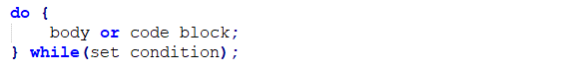
Part 1: Topical Presentation
1. Loops in C++
Do-While Loop
Do-While Loop is variation of the While Loop wherein the conditional statement is at the end of the code block. The code syntax is as follows:
An example will make this clearer.
Notes:
(Do-While…) <click>. Do-While loops starts with the keyword “do”, followed by the code block (loop body) intended to be repeated, enclosed in curly braces, followed by the “while” condition to “continue” inside parenthesis. Note that the “while” condition needs to be terminated by a semi-colon (;). Having the loop body in front of the condition, ensures that the body will execute at least once. <click> (An example…)

Slide 9
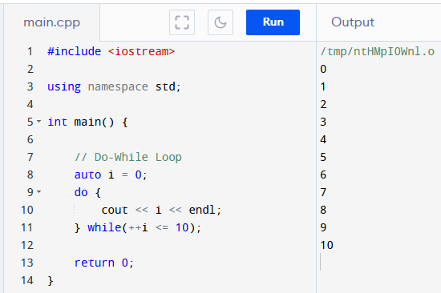
Part 1: Topical Presentation
1. Loops in C++
Do-While Loop (Example)
Notes:
As in while loop. If there is an iterator (in this case “i”) we first initiate it “i=0” <click>. Then <click> we go to the loop body which tells the program what to do while the condition is still met. Then we set the condition at the end of the block<click>. In this case increment i and compare to 10. <click> And In this case print the value of i. <click> The output is the program prints numbers from 0 to 10 to the screen. <click>. The output is different from while loop <click> although they have the same condition. This is because in do-while <click> the body is run first before the condition. Allowing it to print “i” before it is ever updated. <click>

Slide 10
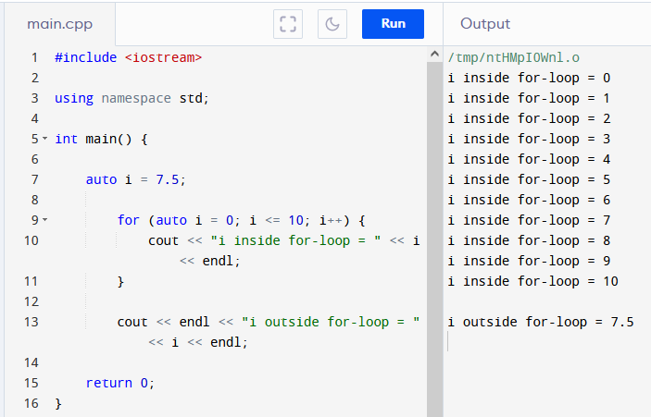
Part 1: Topical Presentation
1. Loops in C++
Scope and Variable Lifetime
A local variable is only valid in the code block it resides on. The validity of a local variable within a code blocks is called its scope.
Variables created inside a loop, lose their scope when the loop ends.
Notes:
Before we continue with the other loop types, we first discuss a few important concepts. First we have <click> (Scope and…) . We also say that the local variable has a lifetime only up to it gets out of scope. Variables are just locations in memory. When a variable goes out of scope the memory allocated to it in the block is freed for use of other processes. <click>
In this example the variable “i” inside the for-block <click> is not the same as the variable “i” outside <click>. As we can see <click> the value of variable “I” inside the block is increasing while the outside “I” value remains the same.
Since the loops we learned so far are essentially code blocks, we need to know that, <click> (Variables…) This is the reason why While-Loops are not recommended to do iteration as the iterator has to be declared outside the loop’s code block. That means the iterator memory allocation is not released when it gets out of scope. Leaving us with an extra variable that we may or may not be able to reuse.

Slide 11
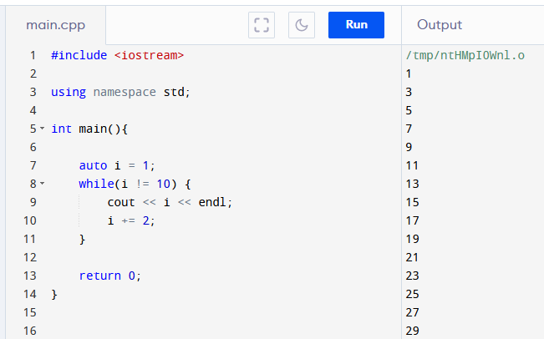
Part 1: Topical Presentation
1. Loops in C++
Infinite Loop
The situation wherein the terminating condition can never be satisfied and therefore the loop cannot terminate, is called Infinite Loop.
Notes:
Loops rely on conditions and limits in order in order to terminate. A well-designed loop should terminate gracefully when the terminating conditions are met. This is not always the case, though. <click> (The situation…) In an infinite loop goes on and on and until your program crashes. This is very bad for your program… and maybe your refutation. So, infinite loop should avoided as much as possible.
<click> (Example) In this example the condition <click> cannot be attained because “I” is only having odd integer values. In the online compiler I am using the program stops when “i=5999”. But on a real app this can potentially run longer than that and eventually it will crash.
There is some use though, for infinite loop however you must know how to exit from infinite loop, which we will discuss in the next slide.

Slide 12
Part 1: Topical Presentation
1. Loops in C++
Break and Continue Statements
Break statement halts the execution of all statements inside the loop, after the “break” and terminates the loop completely.
Continue statement halts the execution of all statements inside the loop, after the “continue” and returns to the start of the loop.
An example will make this clearer.
Notes:
There is a way to prematurely halt the execution of any loop whether infinite loop or not. This is through the use of Break and Continue Statements. <click> (Break…) Break is also use to handle cases in a switch statement but that is outside the scope of this presentation. <click> (Continue…) That means that in this case the loop does not terminate but start over again to the next iteration. <click> (An example…) <click>

Slide 13
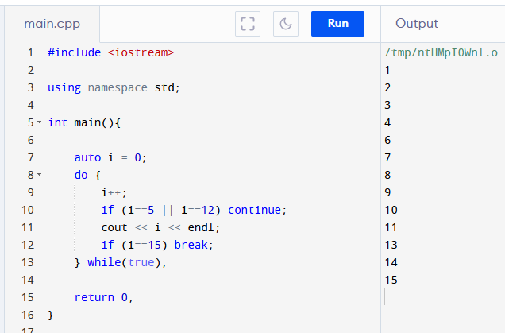
Part 1: Topical Presentation
1. Loops in C++
Break and Continue (Example)
Notes:
In this example, the do-while is potentially an infinite loop. This is because the condition <click> is always “true” and can never be changed. However, because we have this <click> condition and break statement, the loop will terminate at “i=15”. Also because of this <click> continue statement before the call to cout, the program will not print 5 and 12 in the screen, and instead shall continue to the next iteration.

Slide 14
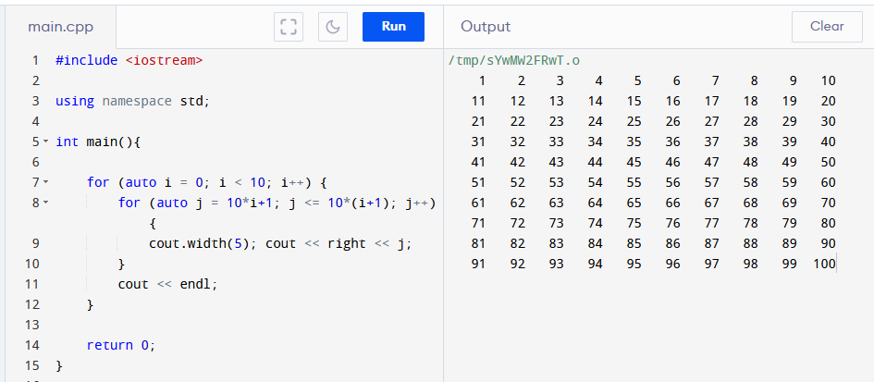
Part 1: Topical Presentation
1. Loops in C++
Nested Loops
Nested loops are loops inside another loop/s.
We need to be careful in using nested loops, as the number of steps is compounded by the number of loops.
Notes:
(Nested…) For example. <click> This program prints the first 100 natural numbers, 10 numbers in each line. The inner loop prints 10 numbers <click> on the screen and the outer loop commands to do the inner loop 10 times <click>. Therefore, <click> (we have…). Making the complexity of the operation to be in the power of the number of loops. In our example, we have 10 outer loops and 10 inner loops so we 10x10 or 100 steps. Imagine having 10 nested loops having 100 steps each. That would be 10^100 steps! Our program would have already crashed before the loop finishes.
Nested loop is one of the reason why a program is slow. The number of nested loops should minimalized. The ability to be nested indefinitely is one of the reasons why looping is not present in most FP languages. <click>

Slide 15
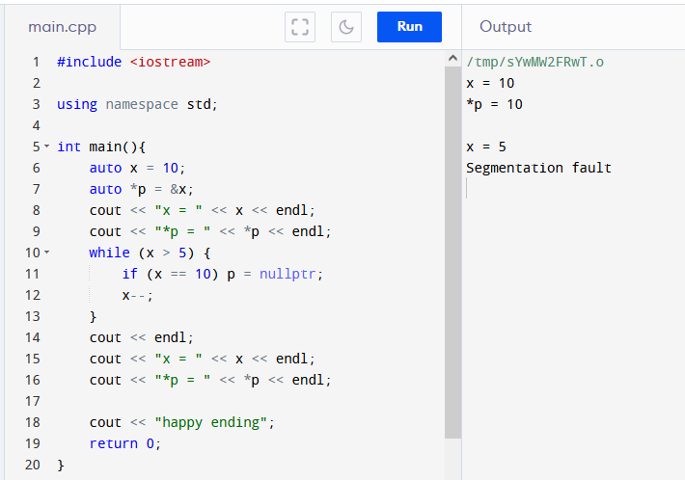
Part 1: Topical Presentation
1. Loops in C++
Side Effects
Side effect is the ability of code block to modify some states outside of its scope.
Notes:
Another reason why loops are frowned upon in the FP community is that it is able to have side effects. <click> (Side effect…). We can see this in our previous examples of while and do-while loops, wherein the iterators are defined outside of the loop and modified inside the loop. But imperative loops can also affect other states. <click> In this example we define a variable x with value 10 and we also defined a pointer p that points to x. <click> We print the value of x and p that clearly shows that p points to x. The while loop is able to change the value of x but also the state of p. By setting p = nullptr we are in effect deleting the pointer. <click> so when we try to print p again, we are faced with “segmentation fault error”, terminates the program and preventing us our <click> happy ending.
This is just a simple example. It is easy to spot the bug. Most of the times the solution is to declare local versions of variables, so we don’t accidentally modify variables outside the scope. We already saw that in our example in “scope and variable lifetimes”. But what if we have long, convoluted nested loops. Debugging can be tedious. This is the reason why that in the FP paradigm side effects are not allowed.
The ability to have side effects, infinite loops and convoluted nested loops are the reasons why most FP languages don’t have loop constructs instead recursion is encouraged. We shall discuss recursion when we get to the topic of functions…

Slide 16
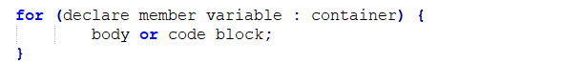
Part 1: Topical Presentation
1. Loops in C++
Range-based For Loop
Range-based For Loop is a way to iterate a container without changing or modifying the content of the container. The code syntax is as follows:
An example will make this clearer.
Notes:
Since 2011, the creators of C++ sought to modernize C++ by including, among other changes, FP paradigm to C++. One of the first changes is the introduction of <click> (Range-based For Loop…). <click> As you can see it has a much simpler and cleaner syntax than its imperative cousin. It begins with the keyword “for” (as usual) <click> followed by enclosed in parenthesis: a declaration of a member variable that represents an element of a container <click>, followed by a colon symbol <click>, followed by the container where the variable belongs and finally followed by the loop body. <click> The colon symbol is read as “inside of” or “an element of”. The container can be any type of data structure in C++. It can be arrays, vectors, lists, strings, etc. (An example…) <click>

Slide 17
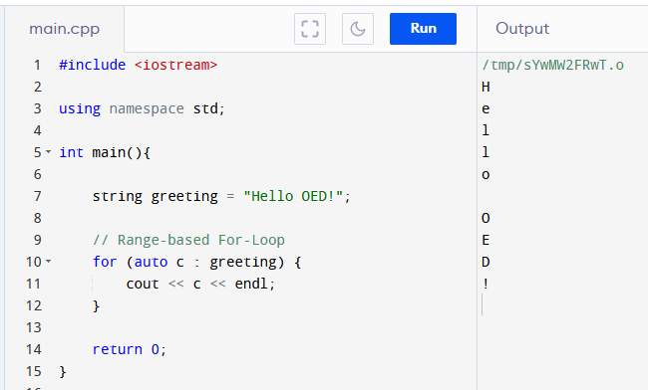
Part 1: Topical Presentation
1. Loops in C++
Range-based For Loop (Example)
Notes:
In this example, we declare a string called <click> “greeting”. We then started a range-based for-loop to iterate through “greeting”. <click> We defined an uninitialized variable “c”, that represents each character in “greeting”, followed by a colon, and then the container string “greeting”. In the body we print each character followed by an “endl” causing the “greeting” to be printed vertically. Note that the reason the characters are written correctly is because string is sequential. For non-sequential data structures like sets, maps and trees, there will be no guarantee that the elements will be process in the order we expect. Also note that range based for loop is not purely functional in the sense that the body of the loop can contain codes that modify external state. Like in our example cout is changing the state of the ouput stream in each step.

Slide 18
Part 1: Topical Presentation
1. Loops in C++
For-each Loop
Like the range-based for-loop, For-Each can be applied to elements of a container. But it is actually a function taking in three parameters. The code syntax is as follows:
An example will make this clearer.
Notes:
Another functional loop type is the for-each loop. <click> (Like the) <click> The loop starts with for (underscore) each, followed by inside parenthesis, a pointer to the element of the container where the function is first to be applied, followed by a pointer to the last element in the container where the function is to be applied, followed by the function itself.

Slide 19
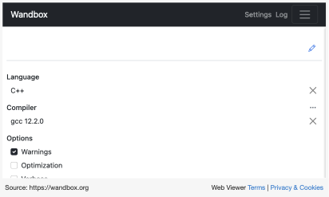
Part 1: Topical Presentation
For-each Loop Example
Notes:
Another functional loop type is the for-each loop. <click> (Like the) <click> The loop starts with for (underscore) each, followed by inside parenthesis, a pointer to the element of the container where the function is first to be applied, followed by a pointer to the last element in the container where the function is to be applied, followed by the function itself.

Slide 20
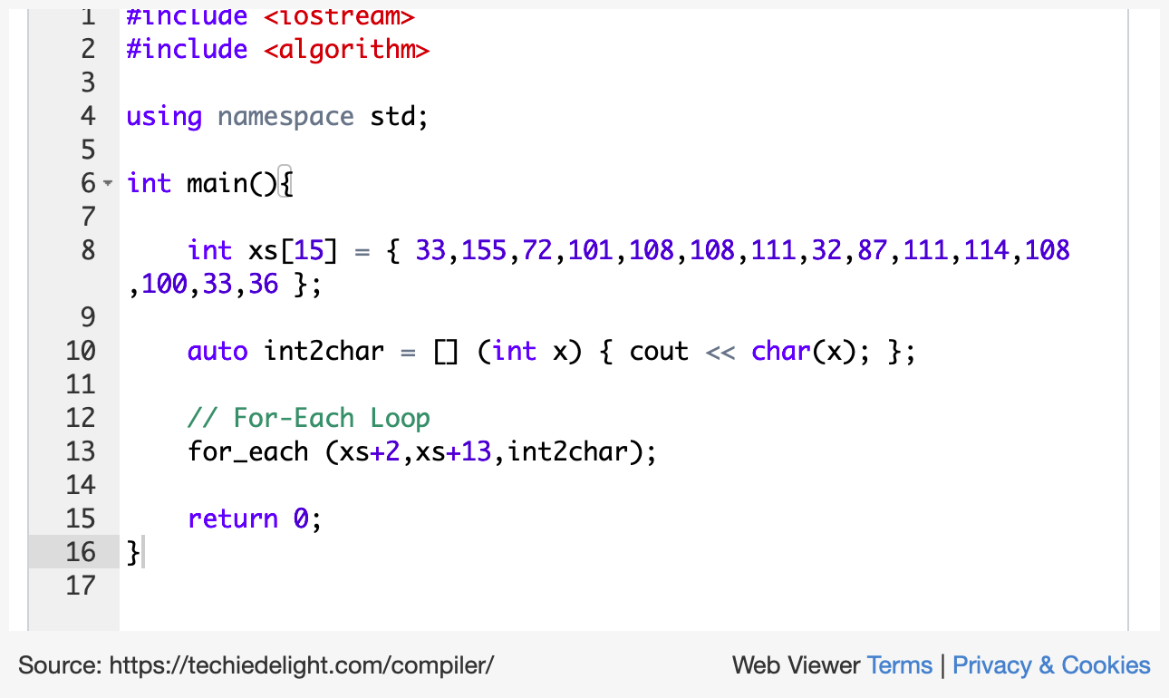
Part 1: Topical Presentation
For-each Loop Example
Notes:
Another functional loop type is the for-each loop. <click> (Like the) <click> The loop starts with for (underscore) each, followed by inside parenthesis, a pointer to the element of the container where the function is first to be applied, followed by a pointer to the last element in the container where the function is to be applied, followed by the function itself.

Slide 21
Thank YOU!!!

